Slide 1

Lesson 8 – Monte Carlo Localization
Intelligent Mobile Robotics
Dr. Aboozar Taherkhani (PhD)
email: aboozar.taherkhani@dmu.ac.uk

Slide 2
Content
Recap
Monte Carlo Localization for 2D
Creating initial believe in 2D space
Prediction in 2D space
Correction in 2D

Slide 3
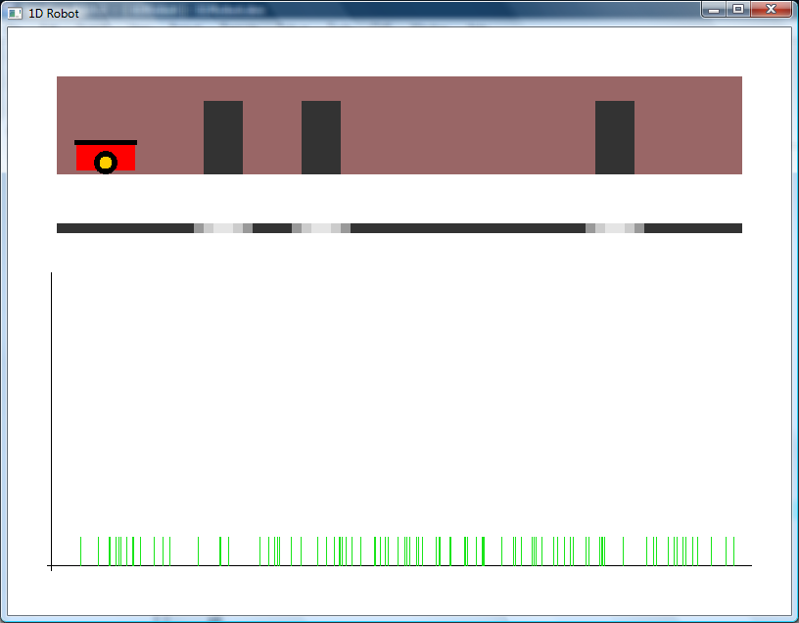
Recap: 1D Robot Localisation Problem
Particle filter in action t=0

Slide 4
Monte Carlo Localization
Localization:
The process of self identification of current position in an existing map
Monte Carlo
Monte Carlo methods use multiple iterative random sampling
Used whenever a closed form (deterministic) solution is not feasible
E.G. Bayesian filter

Slide 5
Monte Carlo Localization
Particle filter is a Monte Carlo method
When applied to localization
Monte Carlo localization
We already done this in 1D
Now lets go for 2D (x, y, θ)

Slide 6
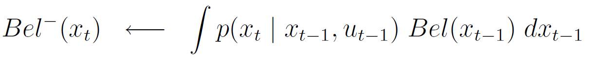
Monte Carlo Localization
Recall Bayesian filter model:
Prediction
Whenever a new measurement u_{t-1} is taken at time t
Correction
Whenever an observation z_{t} is taken at time t

Slide 7
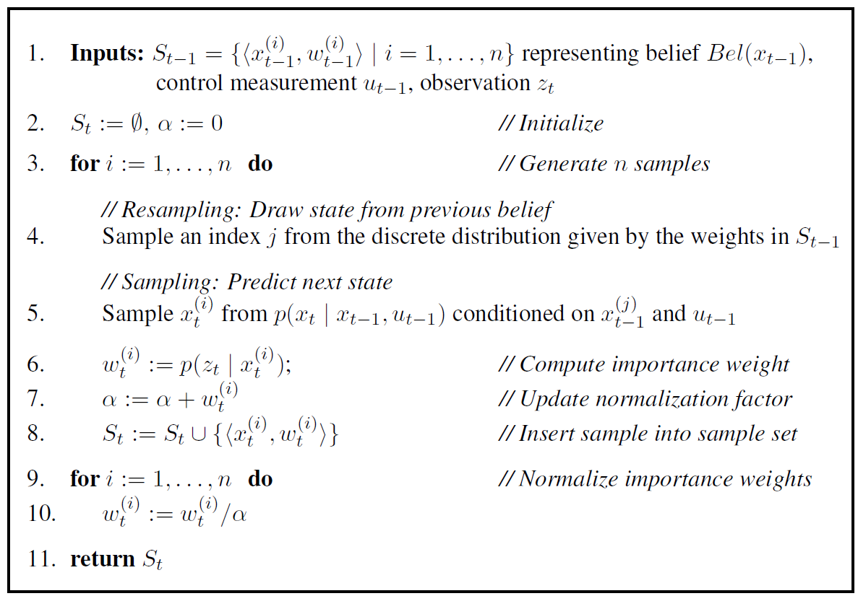
Class activity: In the Particle Filter Algorithm, find which steps are corresponding to 1 - Creating initial believe in 2D space, 2 - Prediction in 2D space, 3 - Correction in 2D

Slide 8
Monte Carlo Localization
We need to update last weeks models for 2D

Slide 9

Monte Carlo Localization
We need to update last weeks models for 2D
x_{t} is a vector (x, y, θ)

Slide 10
Monte Carlo Localization
We need to update last weeks models for 2D
Model of system dynamics is probabilistic
Noise fits a normal distribution
σ
c

Slide 11
Monte Carlo Localization
We need to update last weeks models for 2D
Model of system dynamics is probabilistic
Noise consists of 3 components
X
θ
Y
σ
σ
σ
c
c
c

Slide 12
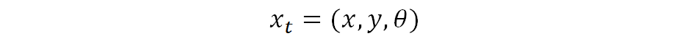

Monte Carlo Localization
Model of system dynamics is probabilistic
We need a function where:
Level of noise is proportional to degree of movement
Level of noise is appropriate for each component
Particle:

Slide 13
Monte Carlo Localization
Model of system dynamics is probabilistic
We need a function where:
Level of noise is proportional to degree of movement
Level of noise is appropriate for each component
From particle at previous time step

Slide 14
Monte Carlo Localization
Model of system dynamics is probabilistic
We need a function where:
Level of noise is proportional to degree of movement
Level of noise is appropriate for each component
From odometry

Slide 15
Monte Carlo Localization
Model of system dynamics is probabilistic
We need a function where:
Level of noise is proportional to degree of movement
Level of noise is appropriate for each component
From Gauss functions

Slide 16
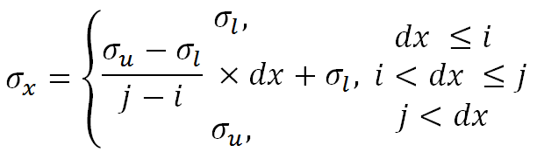
Monte Carlo Localization
Each noise component should be (roughly) proportional to amount of movement
Level of noise is controlled by sigma
Perhaps a reasonable linear function for sigma:

Slide 17
Monte Carlo Localization
σ_{u}
σ_{l}
i
j

Slide 18
Monte Carlo Localization
σ_{u}
σ_{x}
σ_{l}
i
dx
j

Slide 19
Monte Carlo Localization
σ_{u}
σ_{x}
σ_{x}
σ_{l}
i
dx
j
dx

Slide 20
Monte Carlo Localization
To obtain noise in dx
Sampled dx
σ_{x}
dx

Slide 21
Monte Carlo Localization: Prediction phase
Prediction phase algorithm:
Beforehand: obtain suitable values for σ_{l,} σ_{u,} i and j for each component x, y and θ
Find (dx, dy, dθ) from the odometry system
Use linear equations to find values of σ_{x,} σ_{y} and σ_{θ}
Sample values of (dx, dy, dθ)
dx’ = dx X cos(dθ), dy’ = dy X sin(dθ)
Update particle with (dx’, dy’, dθ)

Slide 22
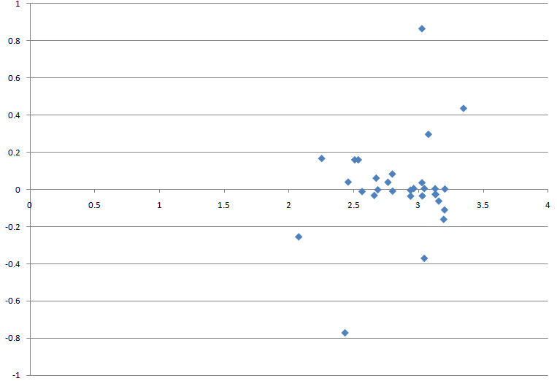
Monte Carlo Localization: Prediction phase
Example:
Robot moves from (0,0,0) by 3cms along x

Slide 23
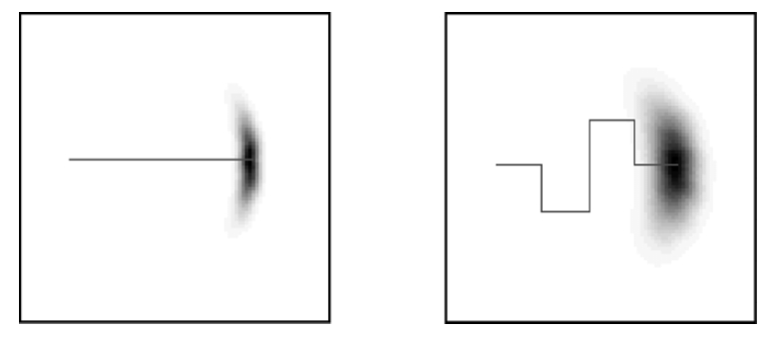
Monte Carlo Localization: Prediction phase
Example (from Thrun et al):
Robot moves 40m and 80m

Slide 24
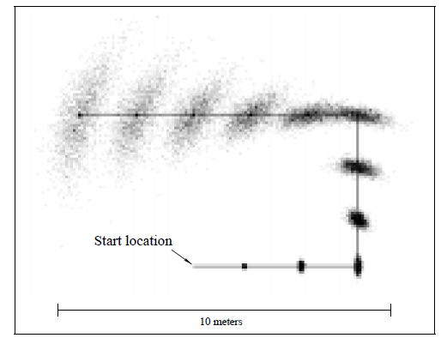
Monte Carlo Localization: Prediction phase
Example (from Fox et al):
Robot moves 10m

Slide 25
Monte Carlo Localization: Correction phase
As with 1D robot from last week
Sonar sensor gives a range and heading to an obstacle
Each particle has a position and heading
Find the value of the occupancy grid at the projected sonar position from the particle
P = 1 - the difference

Slide 26
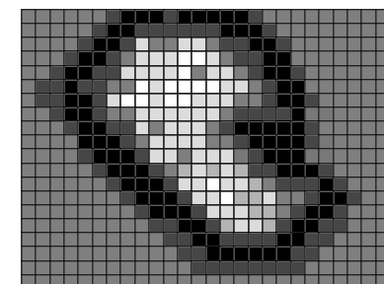
Monte Carlo Localization: Correction phase
Robot
Particle

Slide 27
Bayes’ Filters (update from last week)
Implementation
To implement a Bayesian filter we need to implement three things:
The belief probability density function:
The model of system dynamics
The perceptual model
✓
A set of ordered pairs
(<x, y, θ>, w)
A sample from a complex
model of uncertainty in
system movement
✓
✓
Full occupancy grid
In a particle filter these are all discrete functions

Slide 28
Monte Carlo Localization
Implementation tricks and tips
Reject any samples outside the known environment
You begin with an occupancy grid
Find (by hand) area where the robot can go
Approximate these with:
Bounding boxes
Circles
Reject particles outside these areas

Slide 29
Map Approximation

Slide 30
Map Approximation
r₁
x₁, y₁
x₂, y₂
r₂

Slide 31
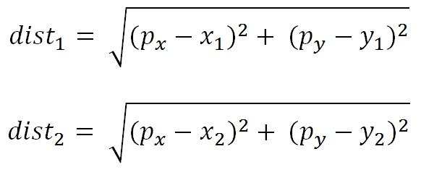
Map Approximation
E.G.
Reject any particle (p_{x}, p_{y}, p_{θ}) if:
dist₁ > r₁ AND dist₂ > r₂
where:

Slide 32
Monte Carlo Localization
Implementation tricks and tips
Reject any particles with a weight of 0
When a particle is rejected a new one must be resampled from scratch to take its place

Slide 33
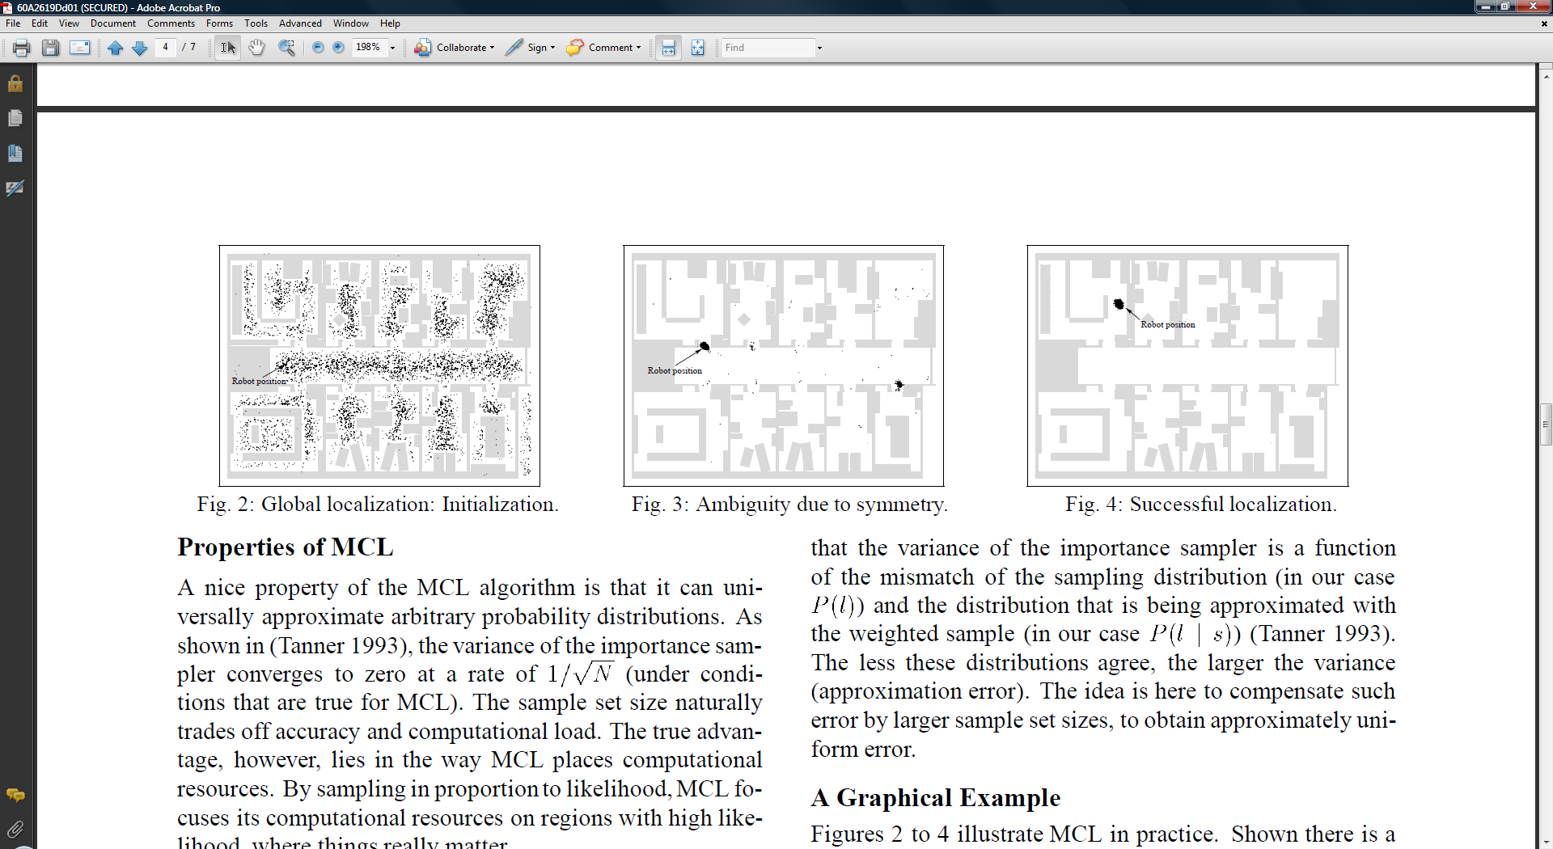
Monte Carlo Localization
Example from Fox et al

Slide 34
Monte Carlo Localization
Example from Fox et al

Slide 35
Monte Carlo Localization
Example from Fox et al

Slide 36
Summary
Monte Carlo Localization is the application of a Bayes’ filter to the problem of localization
This is the subject of you second coursework

